Slide 1
Amdahl’s Law

Slide 2

Gene Myron Amdahl
  Born November 16, 1922
  Norwegian American
  known for his work on mainframe computers at IBM and later Amdahl Corporation.
  Worked on the IBM 704, the IBM 709, and the basis for the IBM 7030. He later worked on the System/360 family architecture.
  Became an IBM Fellow in 1965, and head of the ACS Laboratory in Menlo Park, California.
  In September 1970, he started Amdahl Corporation in Sunnyvale, with aid from Fujitsu.
  He is a Fellow of the National Academy of Engineering and the IEEE and a Distinguished Fellow of the British Computer Society (1979).

Slide 3
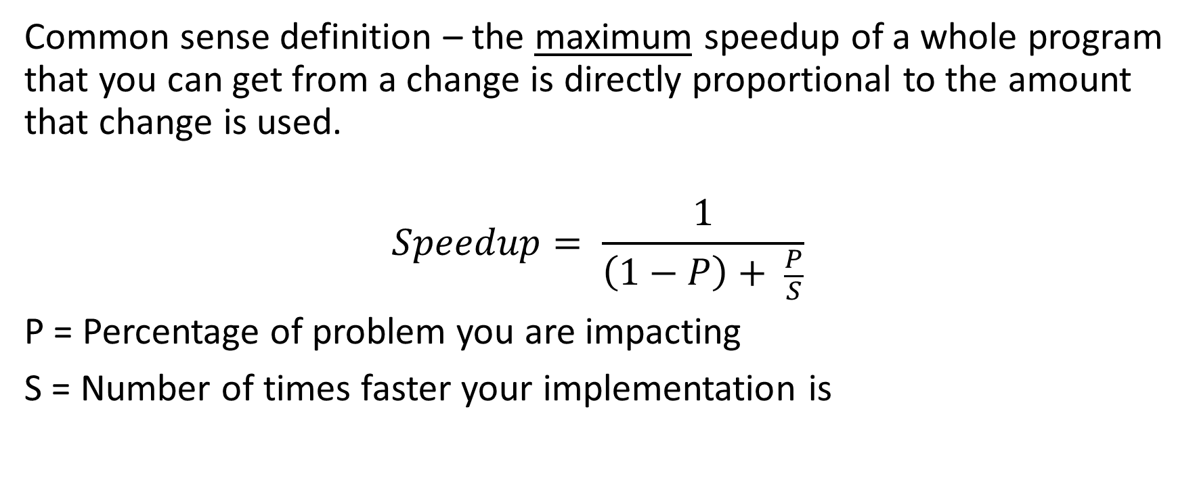
Amdahl's law
Common sense definition – the maximum speedup of a whole program that you can get from a change is directly proportional to the amount that change is used.
$$Speedup= \frac{1}{\left(1−P\right)+ \frac{P}{S}}$$
P = Percentage of problem you are impacting
S = Number of times faster your implementation is

Slide 4
Relevance?
Before doing work to make a feature better/faster, we can do a bit of quick math to figure out the theoretical maximum difference it will make overall.
In computer architecture, we can use this to determine how valuable accelerating a particular operation is.
In computer system performance, we can use Amdahl’s to determine the acceleration of the whole system due to accelerating one part.

Slide 5
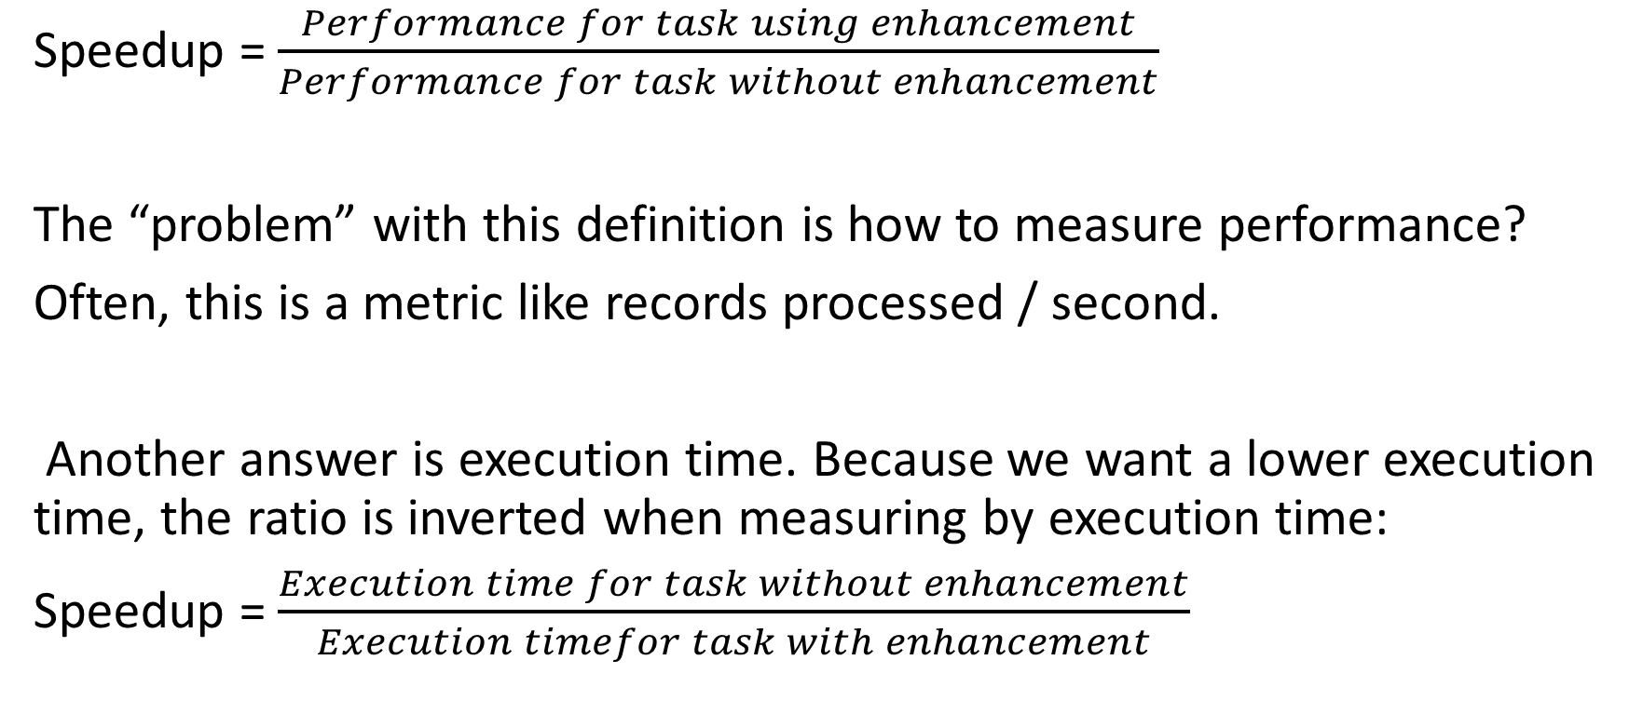
What is speedup?
Speedup = $\frac{Performance for task using enhancement}{Performance for task without enhancement}$
The “problem” with this definition is how to measure performance?
Often, this is a metric like records processed / second.
Another answer is execution time. Because we want a lower execution time, the ratio is inverted when measuring by execution time:
Speedup = $\frac{Execution time for task without enhancement}{Execution timefor task with enhancement}$

Slide 6
Amdahl's law example
You are considering improving your processor for web serving.
You have measured that you can make computation 10 times faster and that computation is about 40% of the runtime of your code (the rest is waiting for I/O).

Slide 7
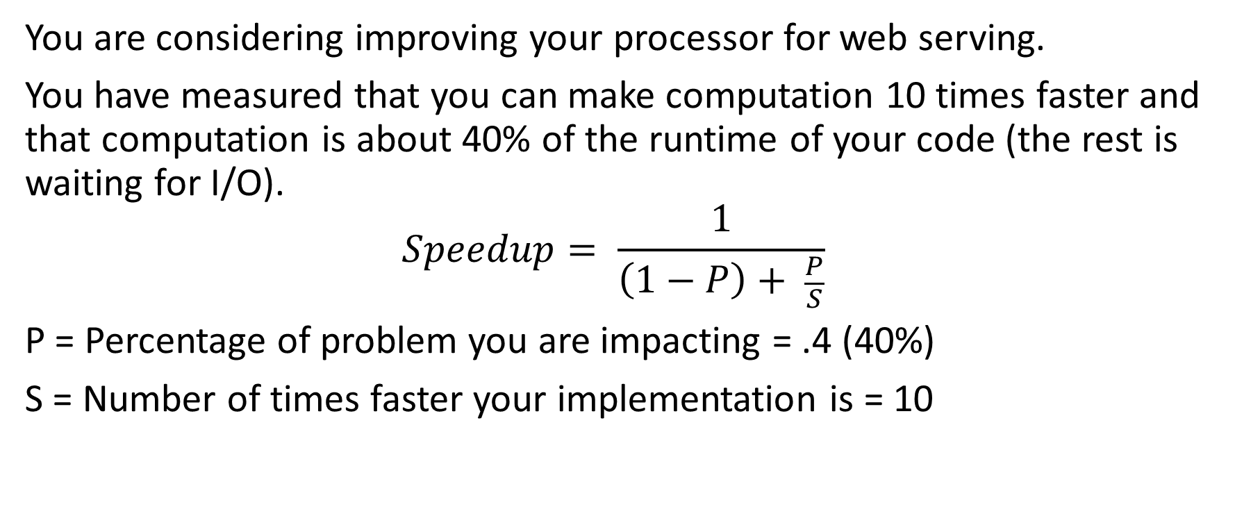
Amdahl's law example
You are considering improving your processor for web serving.
You have measured that you can make computation 10 times faster and that computation is about 40% of the runtime of your code (the rest is waiting for I/O).
$$Speedup= \frac{1}{\left(1−P\right)+ \frac{P}{S}}$$
P = Percentage of problem you are impacting = .4 (40%)
S = Number of times faster your implementation is = 10

Slide 8
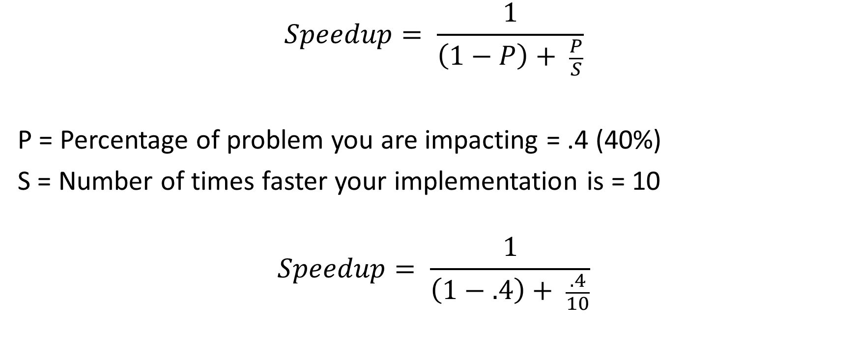
Amdahl's law example
$$Speedup= \frac{1}{\left(1−P\right)+ \frac{P}{S}}$$
P = Percentage of problem you are impacting = .4 (40%)
S = Number of times faster your implementation is = 10
$$Speedup= \frac{1}{\left(1−.4\right)+ \frac{.4}{10}}$$

Slide 9
Amdahl's law example
Speedup = 1/(1-.40) + (.4/10) = 1/(.6 + .04) = 1/.64 = 1.56X speedup
Hint – the speedup is far less important than the frequency of use

Slide 10
Consider two different options…
You manage a team that builds the floating-point unit for a CPU. You have a certain silicon “budget”, and your team has brought you two different ways to allocate those transistors:
1) Square root is about 20% of execution time and the team can make it 10X faster.
2) Make all floating-point instructions 1.6X faster. They are about ½ of the instructions run.
Which do you choose?

Slide 11
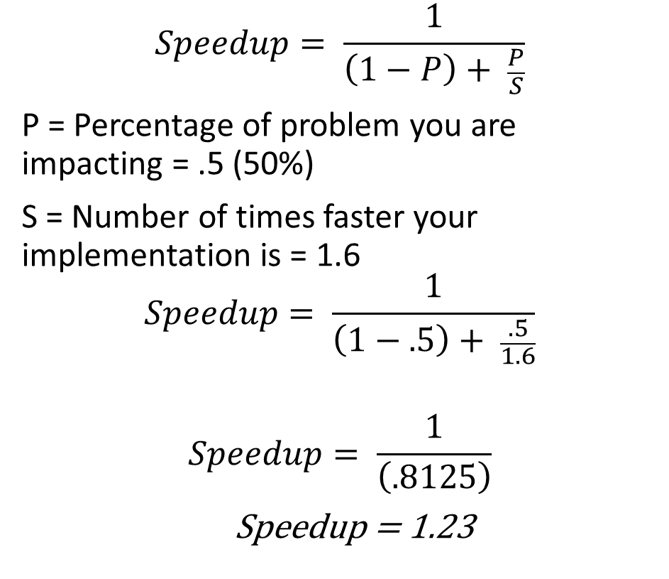
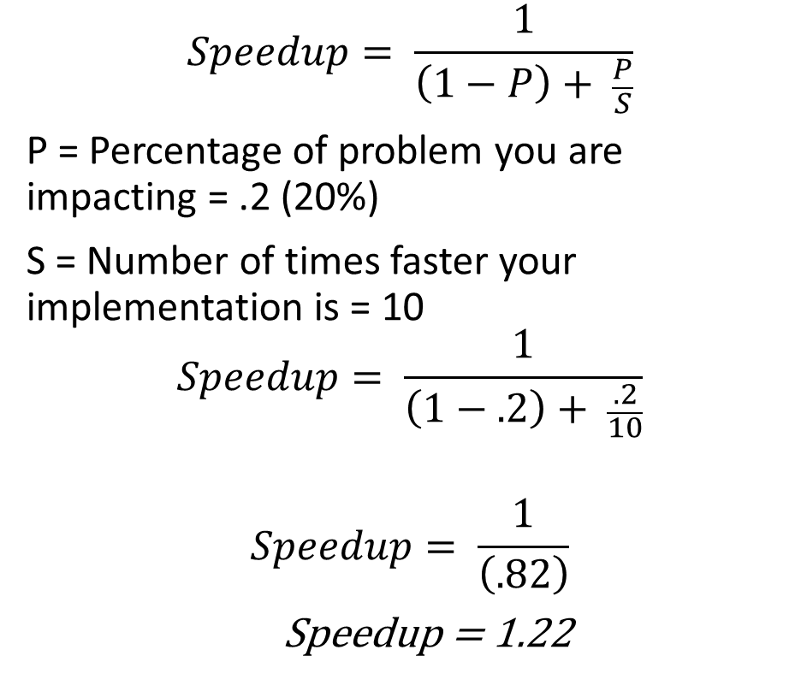
Square Root
Overall improvement
$$Speedup= \frac{1}{\left(1−P\right)+ \frac{P}{S}}$$
P = Percentage of problem you are impacting = .2 (20%)
S = Number of times faster your implementation is = 10
$$Speedup= \frac{1}{\left(1−.2\right)+ \frac{.2}{10}}$$
$$Speedup= \frac{1}{\left(.82\right)}$$
Speedup = 1.22
$$Speedup= \frac{1}{\left(1−P\right)+ \frac{P}{S}}$$
P = Percentage of problem you are impacting = .5 (50%)
S = Number of times faster your implementation is = 1.6
$$Speedup= \frac{1}{\left(1−.5\right)+ \frac{.5}{1.6}}$$
$$Speedup= \frac{1}{\left(.8125\right)}$$
Speedup = 1.23

Slide 12
Amdahl’s Law and Parallelism
This same law applies to making your code run in parallel
If your code has some portion that can NOT be parallelized (startup, accessing common resources), the P will be the percentage of code that CAN be parallelized, and the speedup will be the number of threads you can use.
Keep in mind – Amdahl’s is theoretical MAXIMUM. It’s not a guarantee of that number. Only testing will give you that.

Slide 13
Parallelism Example
What are our dependencies?
What are our parallel opportunities?
We have a program that loads 2 matrices from disk and them multiplies them, writing the result to disk. The pseudo code looks like this:
m1 = Load(filename1)
m2 = Load(filename2)
for (r = 0 to m1.rows)
for (c1 = 0 to m2.cols)
for (c2 = 0 to m1.cols)
m3[r][c1] += m1[r][c2] * m2[c2][c1]
Save(filename3, m3)

Slide 14
Parallelism Example – One Solution
Create thread – load m1
Create thread – load m2 (these 2 threads run in parallel)
Join (wait until both threads end)
Now let’s look at the matrix multiply:

Slide 15
Parallelism Example – One Solution
for (r = 0 to m1.rows)
for (c1 = 0 to m2.cols)
for (c2 = 0 to m1.cols)
m3[r][c1] += m1[r][c2] * m2[c2][c1]
The read and write to m3 can be done by “r” different threads without worrying about them interfering with each other!

Slide 16
Parallelism Example – One Solution
create a thread for each row
for (c1 = 0 to m2.cols)
for (c2 = 0 to m1.cols)
m3[myRow#][c1] += m1[myRow#][c2] * m2[c2][c1]
join (wait) for all threads to complete
Save(filename3, m3)

Slide 17
How much difference will this make?
Let’s assume that for some particular matrices:
Load or Save takes 5 seconds
There are 32 cores on our computer
The matrix multiply took 300 seconds (5 minutes)

Slide 18
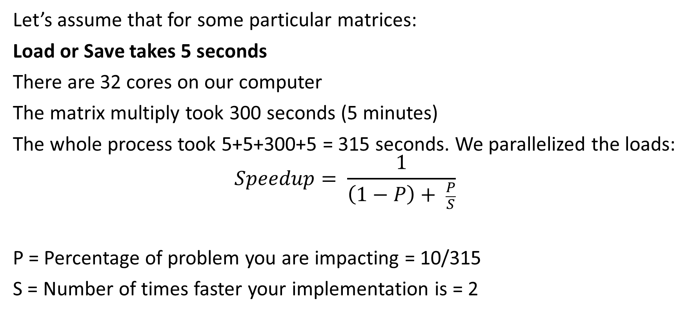
How much difference will this make?
Let’s assume that for some particular matrices:
Load or Save takes 5 seconds
There are 32 cores on our computer
The matrix multiply took 300 seconds (5 minutes)
The whole process took 5+5+300+5 = 315 seconds. We parallelized the loads:
$$Speedup= \frac{1}{\left(1−P\right)+ \frac{P}{S}}$$
P = Percentage of problem you are impacting = 10/315
S = Number of times faster your implementation is = 2

Slide 19
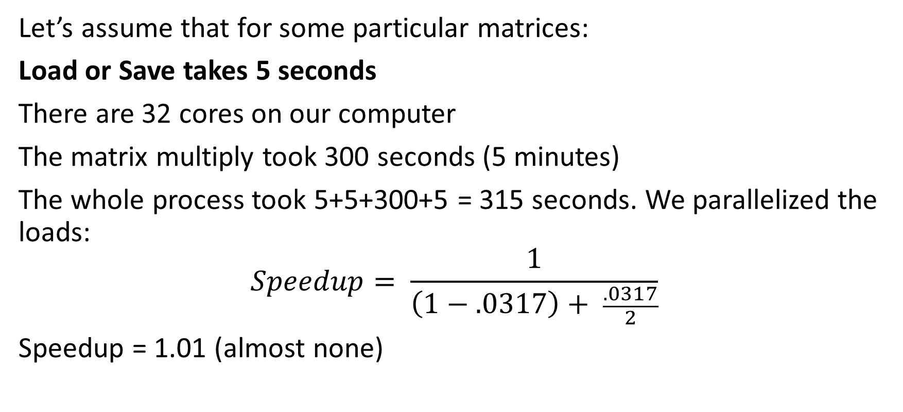
How much difference will this make?
Let’s assume that for some particular matrices:
Load or Save takes 5 seconds
There are 32 cores on our computer
The matrix multiply took 300 seconds (5 minutes)
The whole process took 5+5+300+5 = 315 seconds. We parallelized the loads:
$$Speedup= \frac{1}{\left(1−.0317\right)+ \frac{.0317}{2}}$$
Speedup = 1.01 (almost none)

Slide 20
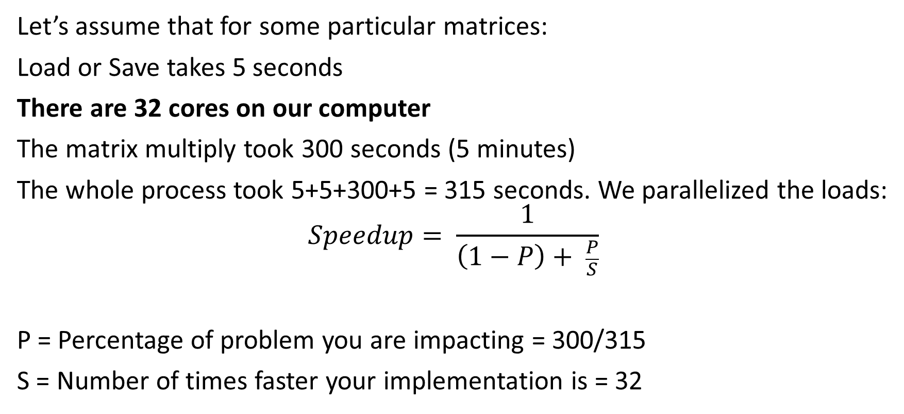
How much difference will this make?
Let’s assume that for some particular matrices:
Load or Save takes 5 seconds
There are 32 cores on our computer
The matrix multiply took 300 seconds (5 minutes)
The whole process took 5+5+300+5 = 315 seconds. We parallelized the loads:
$$Speedup= \frac{1}{\left(1−P\right)+ \frac{P}{S}}$$
P = Percentage of problem you are impacting = 300/315
S = Number of times faster your implementation is = 32

Slide 21
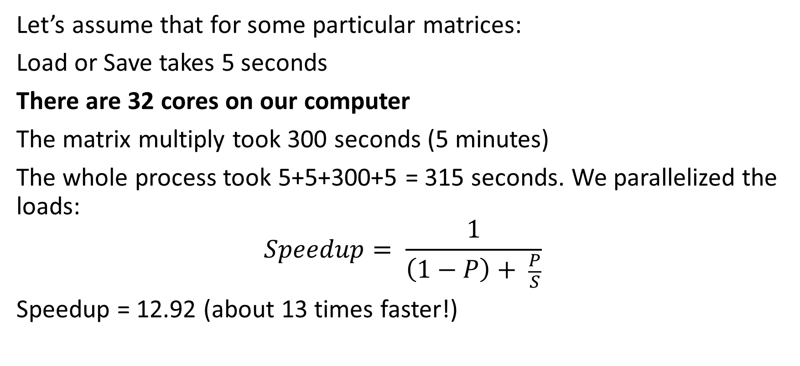
How much difference will this make?
Let’s assume that for some particular matrices:
Load or Save takes 5 seconds
There are 32 cores on our computer
The matrix multiply took 300 seconds (5 minutes)
The whole process took 5+5+300+5 = 315 seconds. We parallelized the loads:
$$Speedup= \frac{1}{\left(1−P\right)+ \frac{P}{S}}$$
Speedup = 12.92 (about 13 times faster!)

Slide 22
13X? For 32 threads?
Those 15 seconds of load/save really make a difference!
This illustrates the law of diminishing returns – adding even more threads won’t make (much of) any difference because the limiting factor is how much time is spent in the accelerated section.

Slide 23
Other uses of Amdahl’s law
I have found Amdahl’s to be a great “guide” for many optimization problems. For example:
When attempting to make code faster, it is important to see which part of the code is slow. Spending a long time optimizing some portion of the code that only takes 5% of the run time is not really very helpful.
If you need to tighten your (household) budget, you should start with the items in the budget that are the biggest. It’s “helpful” to cut your $1/week candy bar out of the budget, but it’s less helpful than saving 15% on your rent!

Slide 24
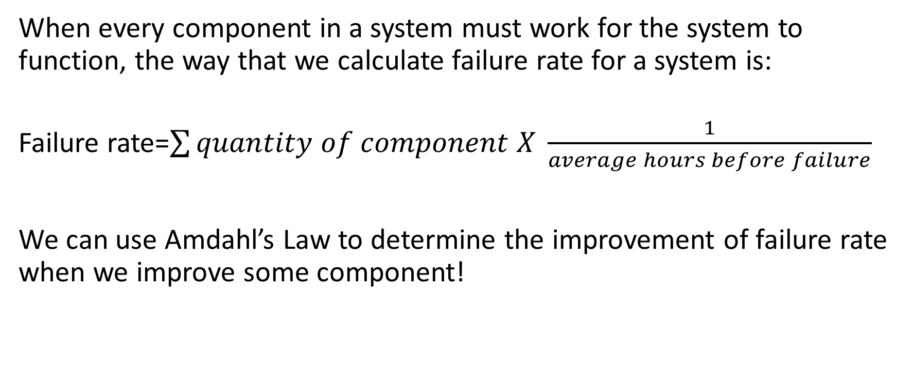
Use in Computer Design
When every component in a system must work for the system to function, the way that we calculate failure rate for a system is:
Failure rate=$\sum{quantity of component X \frac{1}{average hours before failure}}$
We can use Amdahl’s Law to determine the improvement of failure rate when we improve some component!

Slide 25
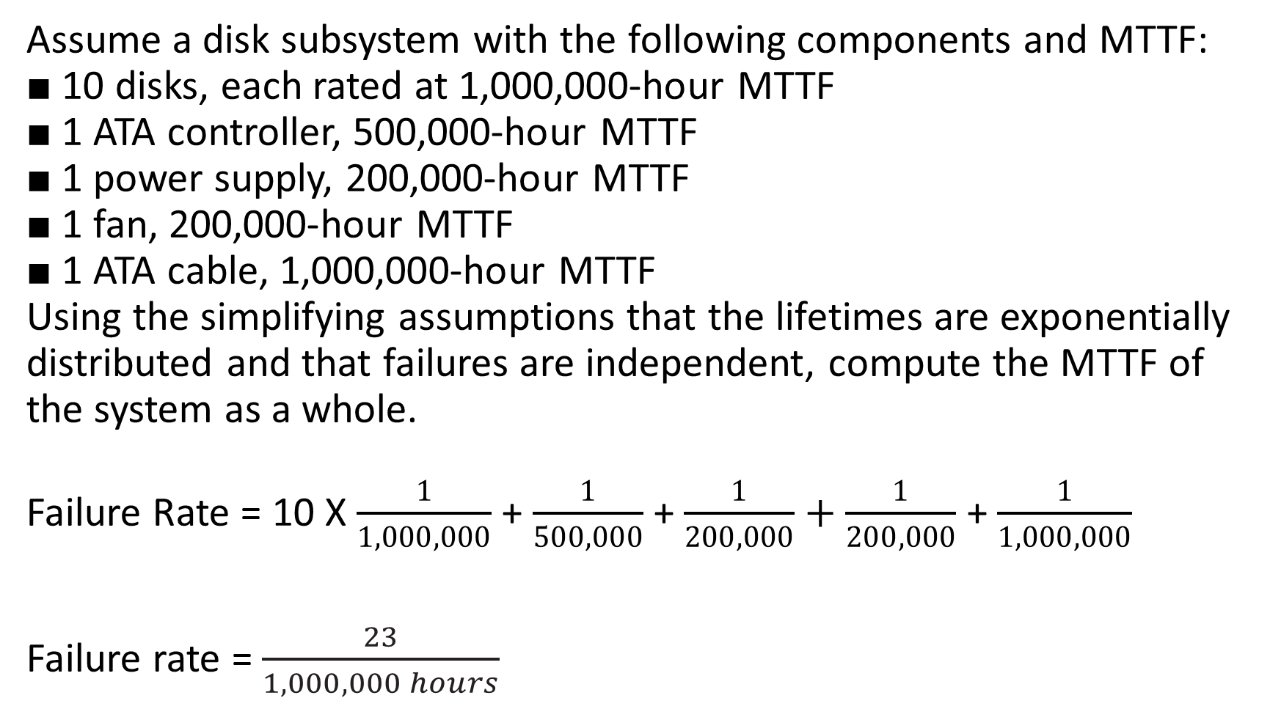
Assume a disk subsystem with the following components and MTTF:
■ 10 disks, each rated at 1,000,000-hour MTTF
■ 1 ATA controller, 500,000-hour MTTF
■ 1 power supply, 200,000-hour MTTF
■ 1 fan, 200,000-hour MTTF
■ 1 ATA cable, 1,000,000-hour MTTF
Using the simplifying assumptions that the lifetimes are exponentially distributed and that failures are independent, compute the MTTF of the system as a whole.
Failure Rate = 10 X $\frac{1}{1,000,000}$ + $\frac{1}{500,000}$ + $\frac{1}{200,000}+\frac{1}{200,000}$ + $\frac{1}{1,000,000}$
Failure rate = $\frac{23}{1,000,000 hours}$

Slide 26
What if we improve one component?
We had this: 1 power supply, 200,000-hour MTTF
What if we put a much better power supply in? One that fails in 1/830,000,000 hours? How would that improve our failure rate?
Our power supply was 1/200,000 hours or 5/1,000,000 hours. The whole system was 23/1,000,000 hours, so it is 22% of failures.

Slide 27
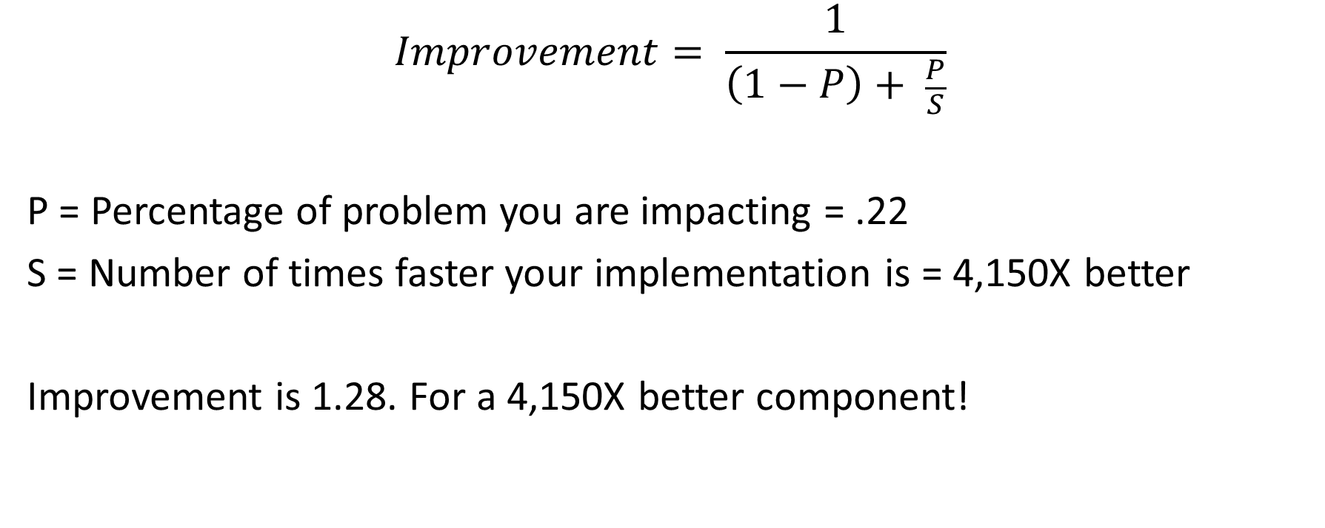
Use some Amdahl magic…
$$Improvement= \frac{1}{\left(1−P\right)+ \frac{P}{S}}$$
P = Percentage of problem you are impacting = .22
S = Number of times faster your implementation is = 4,150X better
Improvement is 1.28. For a 4,150X better component!

